Slide 1
Startup Companies Analysis
Group 2
Ashraf Adel 196280
Farah Aymen 194233
Aissatou Aida 197346

Slide 2
TABLE OF CONTENTS
01
02
03
Introduction & PreProcessing
Analysis OverView
Analysis Results & Conclusion
Scope of the data and points of interests
Analyising the data from different critical points and aspects
Results deduced from the analysis and its effectiveness

Slide 3
Introduction
Decision making while kickstarting a company can be rather critical.
Analysis and further insights can be a starting guide!

Slide 4
Our Scope
Our data gathers information of around 60 thousand startup company regarding their name, location, category, etc.
The goal is to determine the main crucial factors that may affect the rise or fall of a startup.(e.g. fundings, investments, acquisitions, taxes, etc.).
Acquire additional data to support further insights into the analysis

Slide 5
Cleaning our Data
Organize
Impute missing values
Handle Outliers
Merge Data
Organize the dataset and determine what needs to be cleaned
Fill missing data with average values
Drop irrelevant data
Join all data together to form a solid picture

Slide 6
Obstacles Faced

Slide 7
Finding a source for scrapping
The original data was brought from crunch base, but scrapping additional data from it was impossible as it was “immune” to scrapping.
The website was so secure it detected anonymous scrapping bots and other techniques.
Finding information about companies is in general difficult as they are considered confidential.

Slide 8
Thinking of another source

Slide 9
Another failed attempt
What is another source that can have all information about any company? LinkedIn!
Unfortunately, it detected the scrapping bots and blocked it
But, this isn’t the end…

Slide 10

Finding the Solution!
An API that displays information of any company it has in its database.
So, we scrapped the companies’ annual revenue, their country, number of technologies used, and number of employees.

Slide 11

Analysis Questions

Slide 12
Question:
01
Can the factors that affect a start-up’s growth be determined?

Slide 13
Solution:
01
Two Factors Are Considered:
1. Amount Of Funds
2. Time Before First Fund

Slide 14
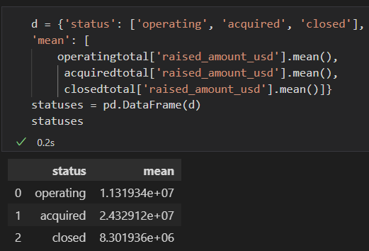
1. Amount Of Funds
Steps:
1. Joined companies and rounds dataframes
2. Got the average of all funding in operating, closed, and acquired companies

Slide 15
1. Amount Of Funds
Visualization:
Analysis:
Company Status
Acquired companies’ “funds” makes sense
Operating
operating funds > closed funds
Acquired
Conclusion:
Closed
Getting funded is critical??
0 5 10 25
Raised Funds in 1 million (avg)

Slide 16
~ distribution of companies
Visualization:
Analysis:
In #funds & #companies, the operating companies are dominating the dataset
11%
8%
operating companies >>> closed companies
82%
Conclusion:
Getting funded is not critical
operating
acquired
closed

Slide 17
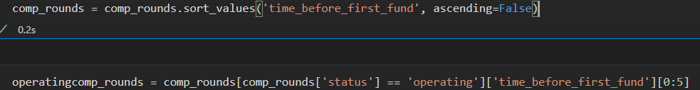
2. Time before first fund
Steps:
1. Created a feature that represents the time (in days) between a company’s establishment date and the first time it got funded
2. Sorted based on created feature and compared the first 5 companies in the two dataframes
3. Split the merged companies/rounds dataframe (from approach 1) to 2 dataframes representing operating and closed companies

Slide 18
2. Time before first fund
Visualization:
Analysis:
Days before
first fund
operating
Time for operating companies to get funded >>> closed companies
closed
100k
80k
60k
40k
20k
This large gap leads us to believe that the companies were still operating regardless of it getting funded
Conclusion:
Group A Group B Group C Group D Group E
The time it takes for a company to get its first fund isn’t critical to its success
Groups of operating and closed companies

Slide 19
Solution:
01
Two Factors Are Considered:
1. Amount Of Funds
2. Time Before First Fund

Slide 20
Question:
02
Which countries are most probable to have the most failed startups?

Slide 21
Solution:
02
Ratio between operating and closed companies in a country

Slide 22
Categorizing the companies
We will categorize the companies according to their status: operating, closed, acquired or IPO so we can compare between them.
Company Status
Operating
Closed
Acquired
IPOs

Slide 23
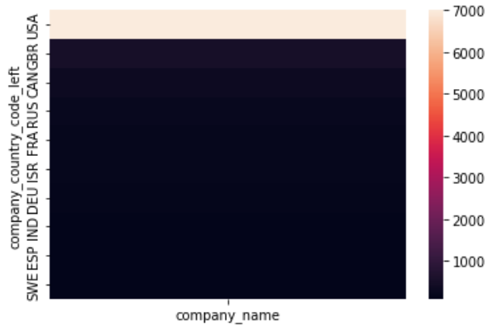
Grouping by the country
We will group by the country to see the number of companies (of each status) in each country to gain insight if there's a massive difference between the number of operating companies and closed ones in a single country.
The heatmap that illustrates. that the US has the most closed companies while others have less

Slide 24
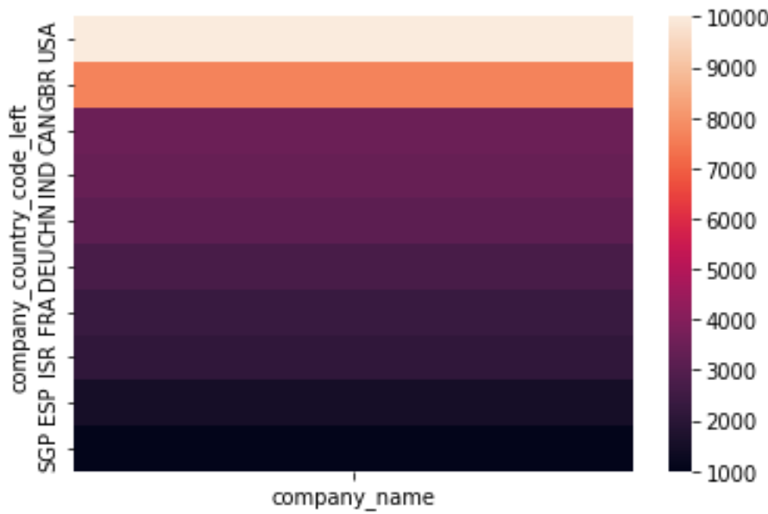
Grouping by the country
The heatmap yet again shows that the US has the most operating companies which seems noticeable because it also had the most closed companies.
After looking in the closed and operating companies we see that we still can't determine if the country has more operating companies than the closed or not, so let's take one country and compare.

Slide 25
Focusing on the USA
The previous heatmaps show us how although the US has strong economics and massive amount of investors, it has a bulk of closed companies, but compared to operating it's only 0.08 (7956/92228) of it. So, this reflects that The US must have facilities and enough fundings for startups.

Slide 26
Conclusion
As the ratio the ratio between the closed to operating companies increases, the more difficult it is for a company to start up.
This will lead us to look closed into factors that makes those countries a difficult place to start a company.

Slide 27
Question:
03
How the number of investors in a country can affect the number of successful companies?

Slide 28
Solution:
03
Two Factors Are Considered:
1. Investors of closed companies
2.Investors of operating companies

Slide 29
Focusing on Investors
The number of investors investing in a company can be a great factor in influencing the success of this company.
Let’s narrow down the investors who are in the same country of the company, and categorize the companies by their status.

Slide 30
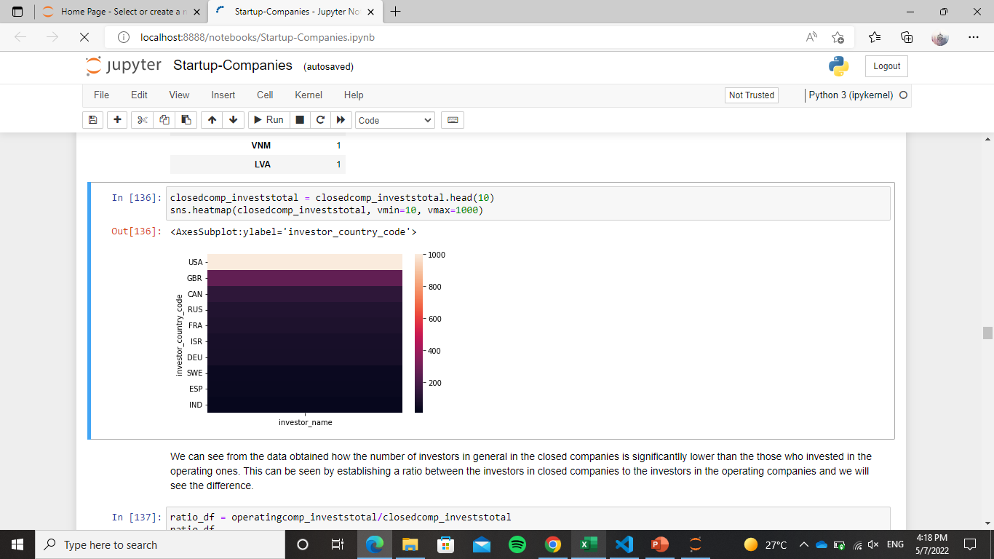
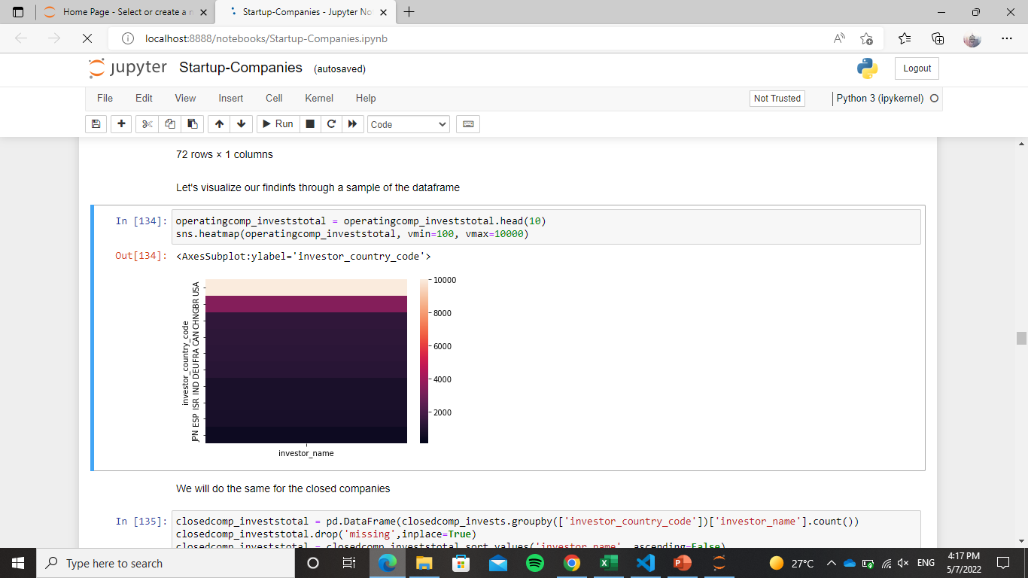
Investors of the closed and operating companies
As seen, the number of investors in each country investing in the operating countries is way less than the closed ones.
To illustrate more, constructing a ratio will make it clearer.
Closed Companies
Operating Companies

Slide 31
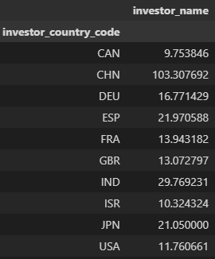
Constructing ratio
Constructing a ratio of the number of operating companies to closed ones that investors invested in according to the countries
it is clearly seen that all of the ratios are > than 1 which means that more investors invested in those companies that helped them in sustaining being operating.

Slide 32
Conclusion
Investing plays an important part in keeping the company operating. As the number of investors increases, the chance of success increases.
The companies that had much investors to invest it made it other than those who haven’t had many.

Slide 33
Question:
04
Which category attracts most funding?

Slide 34
Solution:
04
Two Factors Are Considered:
1. Amount Of Funds
2. Time Before First Fund

Slide 35
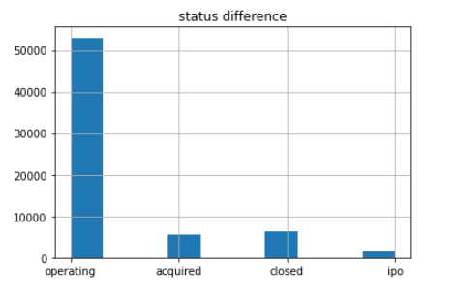
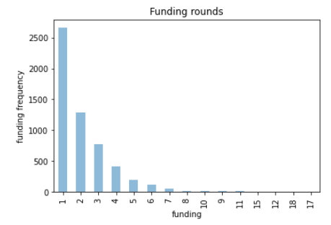
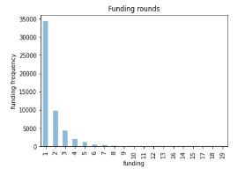
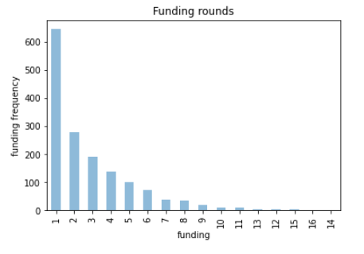
Acquired companies
IPO companies
Visualizing Categories and fundings
Operating companies

Slide 36
Question:
05
How many investors do we have in different countries and which country dominates?

Slide 37
Solution:
05
Two Factors Are Considered:
1. Amount Of Funds
2. Time Before First Fund

Slide 38
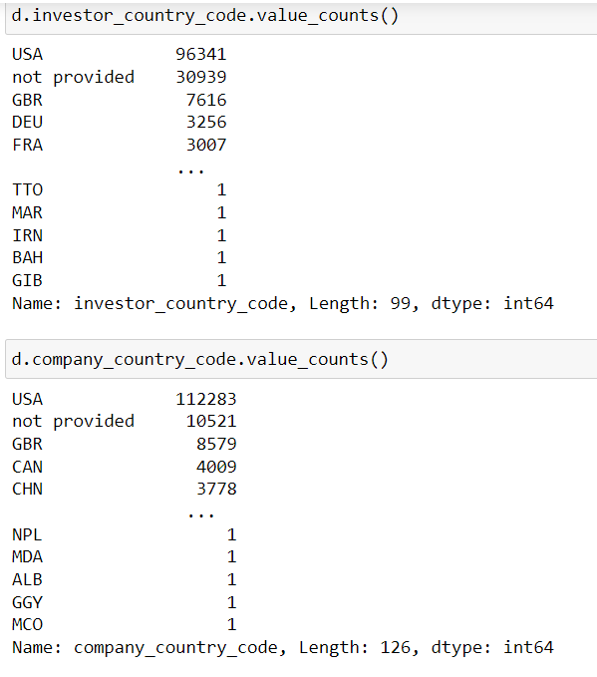
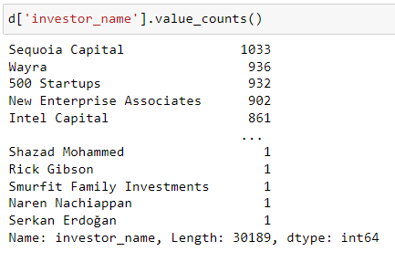
Most famous investors
Investor and company country codes
Investors and companies

Slide 39
Question:
06
Can the factors that affect a start-up’s growth be determined?

Slide 40
Solution:
06
Two Factors Are Considered:
1. Amount Of Funds
2. Time Before First Fund

Slide 41
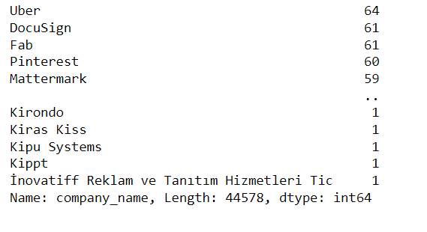
Most famous companies among investors
How many specializations do we have?

Slide 42
Question:
07
Companies specializations and the ones of interest in the investor’s point of view

Slide 43
Solution:
07
Two Factors Are Considered:
1. Amount Of Funds
2. Time Before First Fund

Slide 44
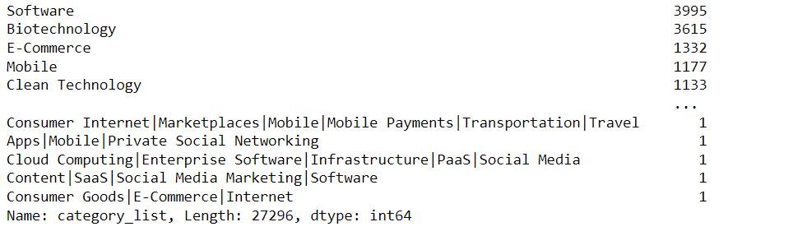
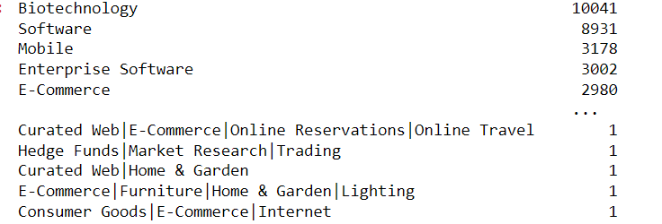
Specializations and investors
Important fields in companies point of views
Important fields in investors point of views

Slide 45
Question:
08
Are most of the investors also acquirers?

Slide 46
Solution:
08
Two Factors Are Considered:
1. Amount Of Funds
2. Time Before First Fund

Slide 47
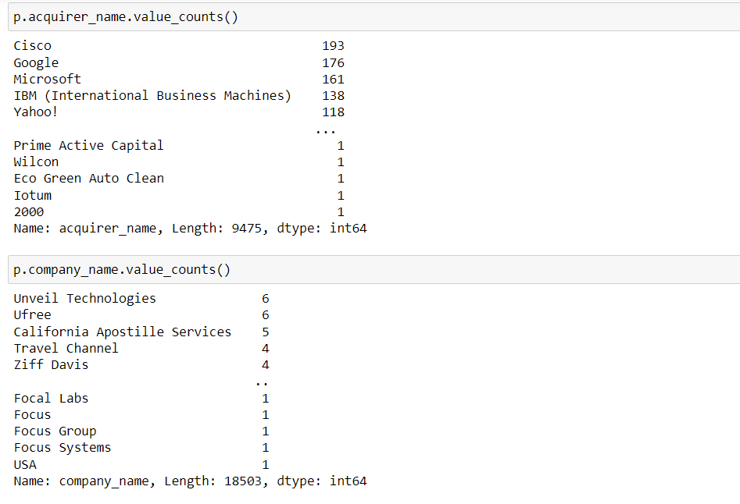
Acquirers and acquirees
Acquirer names and company names in the acquisition data set

Slide 48
Scrapping-based Questions
scrapped the companies’ annual revenue, their country, number of technologies used, and number of employees from Apollo website using the following steps:

Slide 49
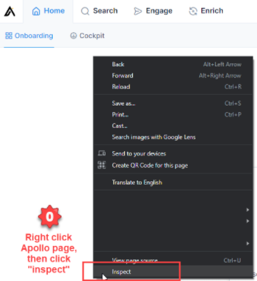
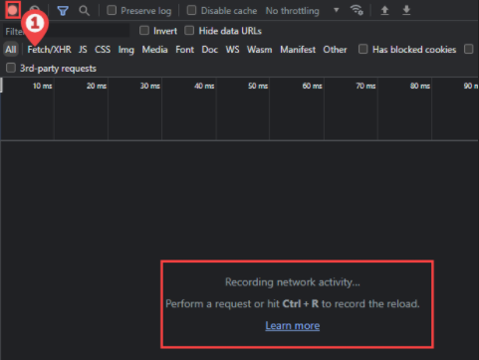
Step 1: obtained cookies from website:

Slide 50
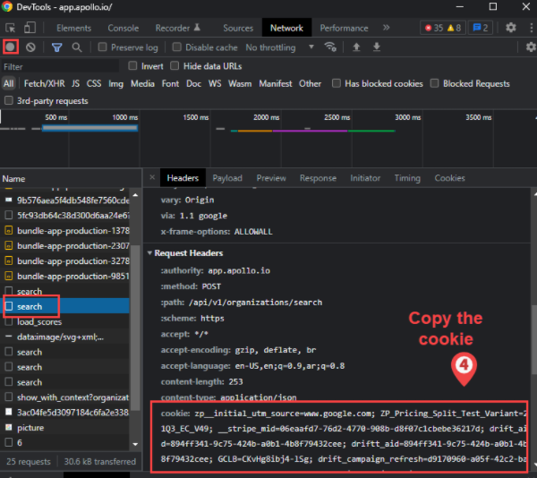
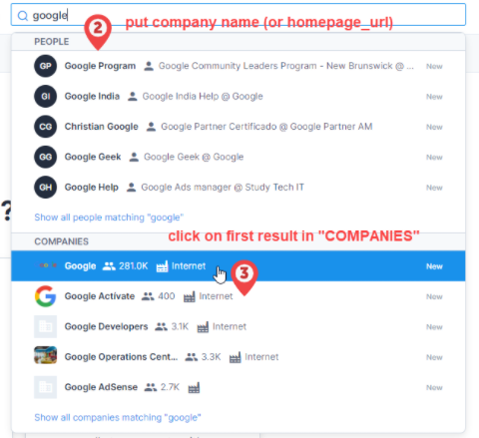
Step 1: obtained cookies from website:

Slide 51
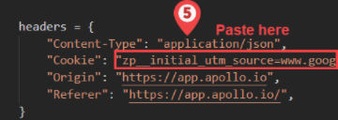
Step 1: obtained cookies from website:

Slide 52
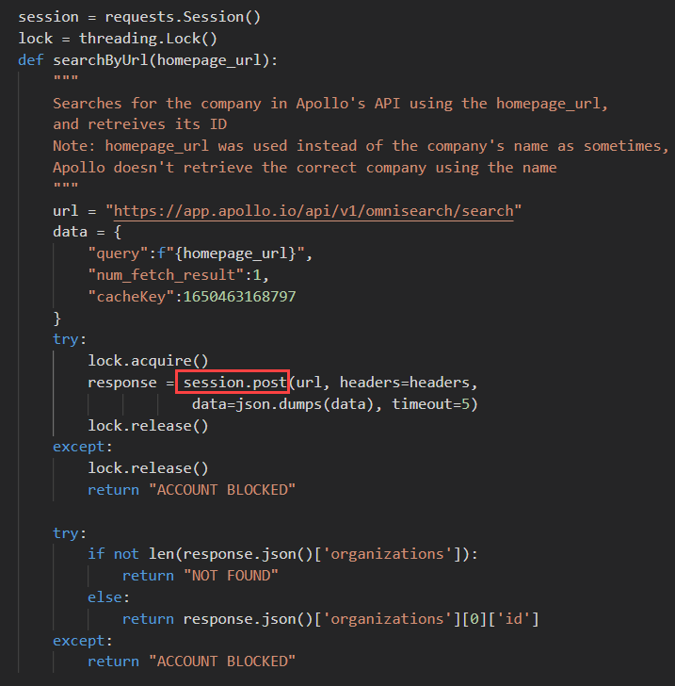
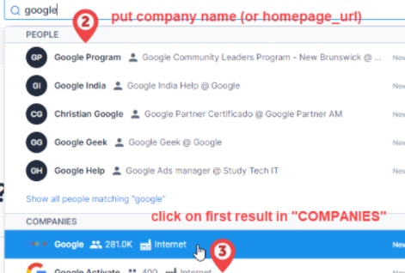
Step 2: Code to post a request to a company’s “id” that Apollo stores:

Slide 53
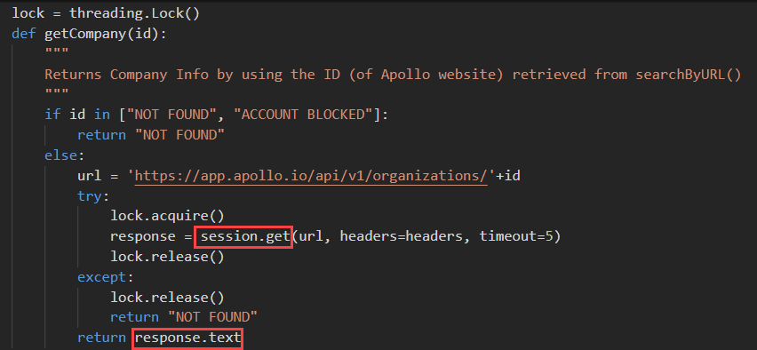
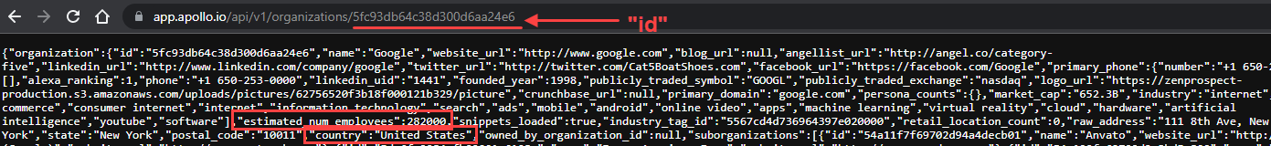
Step 3: Using that “id” to get the company’s link and retrieve the website’s info (JSON string):

Slide 54
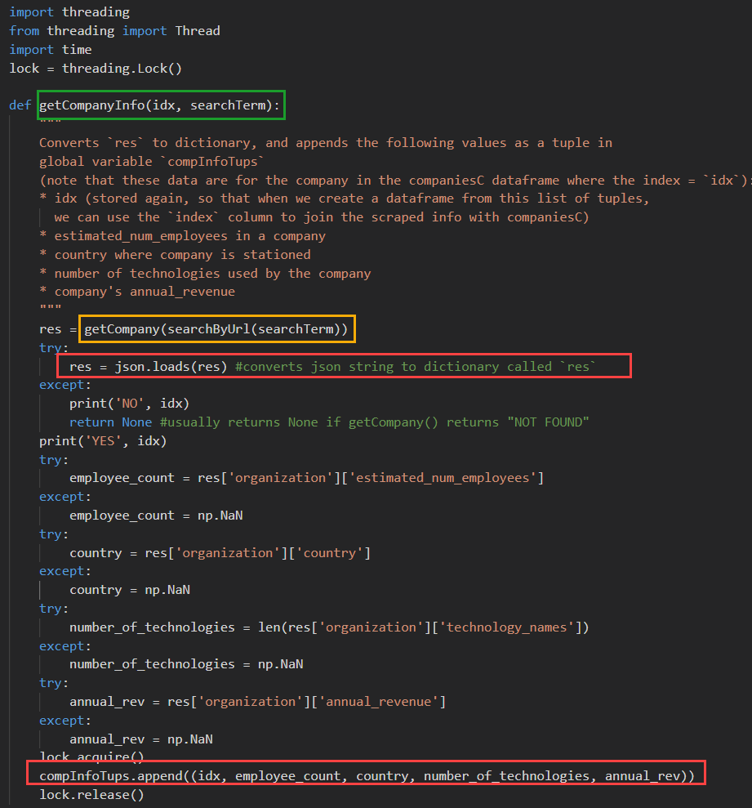
Step 4: converting the website’s JSON to a dictionary and retrieving the required info:

Slide 55
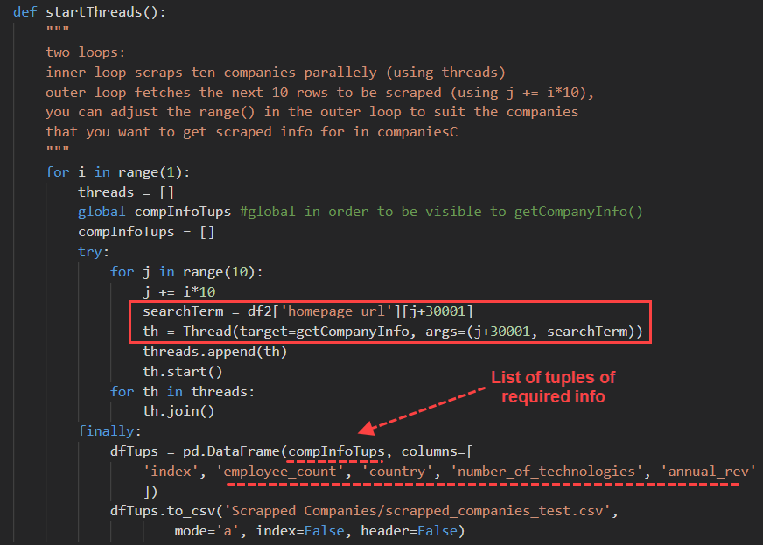
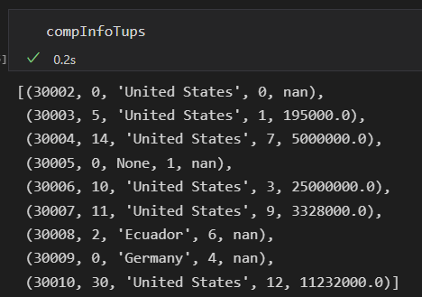
Step 5: retrieving required info from getCompanyInfo() in batches of 10 threads (i.e. ten simultaneous requests)
Result:

Slide 56
Questions that used the scrapped info

Slide 57
Time-Changing Question:
09
Do country taxes play an important factor in deciding a start-up’s success?

Slide 58
Solution:
09
Two Approaches:
1. Taxes W/ Company Status
2. Taxes W/ Avg Funding

Slide 59
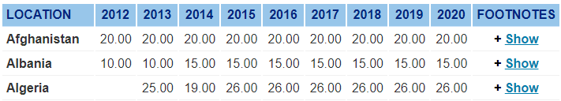
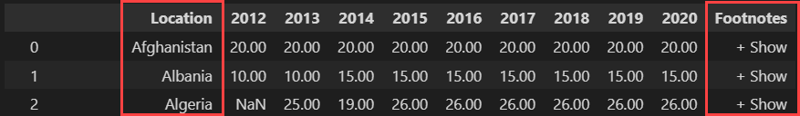
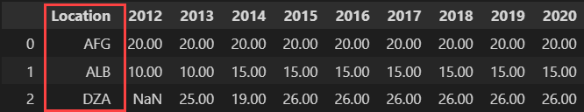
1. Taxes W/ Company Status
Steps:
1. Scraped countries’ taxes from KPMG
pd.read_html(pgSrc)
2. Cleaned scraped data
pycountry.countries.get(name=country)
.alpha_3

Slide 60
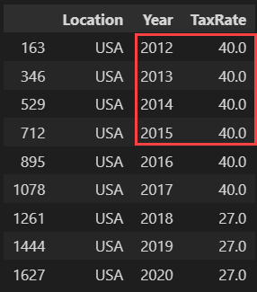
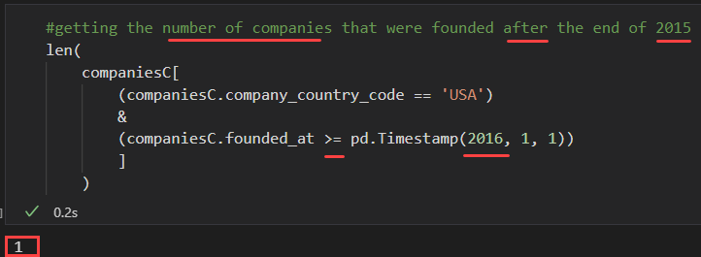
1. Taxes W/ Company Status
Steps:
4. Initially chose USA
However…
3. Visualized #companies in each country in our dataset to choose taxes for the country that appeared the most
USA
35K
5K
N/A
4K
GBR
2.5K
CAN
#Companies
#Country Code

Slide 61
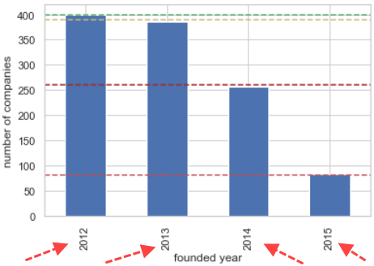
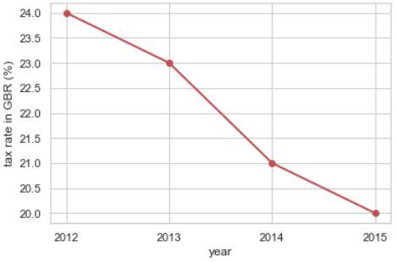
1. Taxes W/ Company Status
Steps:
5. Then we tried GBR:
3. Visualized #companies in each country in our dataset to choose taxes for the country that appeared the most
USA
35K
5K
N/A
4K
GBR
2.5K
CAN
#Companies
#Country Code

Slide 62
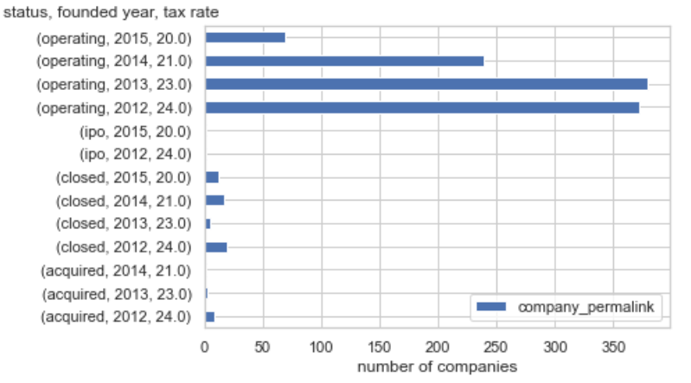
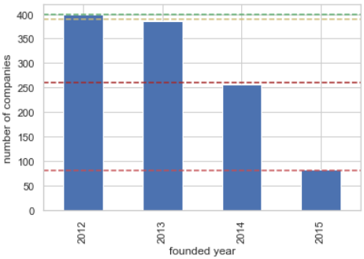
1. Taxes W/ Company Status
Visualization:
Analysis:
Recall: most were operating, and #companies aren’t distributed evenly throughout the years

Slide 63
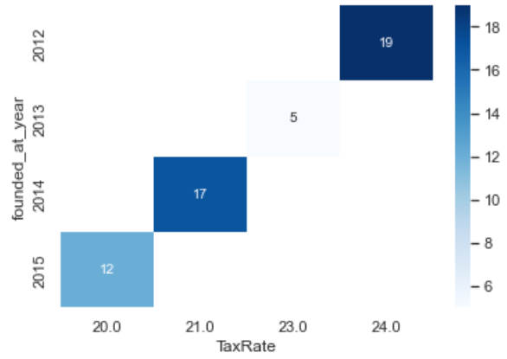
1. Taxes W/ Company Status
Visualization:
Analysis:
#closed companies:
2012 > 2014 > 2015 > 2013
(24) (21) (20) (23)
Therefore, no apparent correlation
Conclusion:
Tax rate doesn’t affect a company’s status

Slide 64
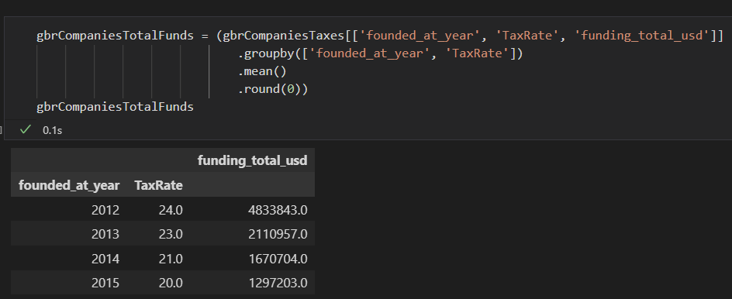
1. Taxes W/ Avg Funding
Steps:
1. Grouped by the company’s establishment year and the tax rate to obtain the average of total companies’ funding at that year

Slide 65
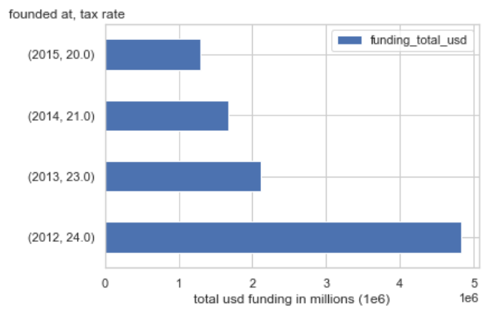
1. Taxes W/ Company Status
Visualization:
Analysis:
Recall: #companies aren’t distributed evenly throughout the years
Let’s append that info on
our horizontal bar graph!

Slide 66
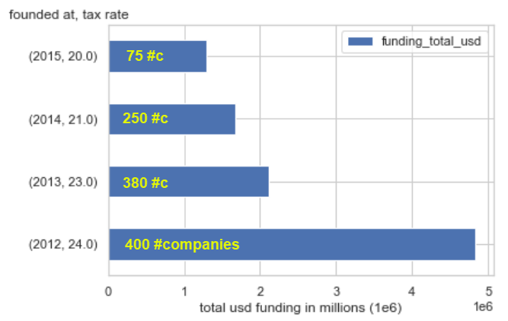
1. Taxes W/ Company Status
Visualization:
Analysis:
2012’s #c ~= 2013’s #c
2012’s company Funds >>> 2013’s company Funds
2014’s #c >> 2015’s #c
2014’s company Funds ~= 2015’s company Funds
Conclusion:
Tax rate has a slight inverse correlation with stockholders funding a company

Slide 67
Solution:
09
Two Factors Are Considered:
1. Taxes W/ Company Status
2. Taxes W/ Avg Funding

Slide 68
Question:
10
Dos the number of employees
affect the success of the company?

Slide 69
Solution:
10
Influence of employees factor on each company status.

Slide 70
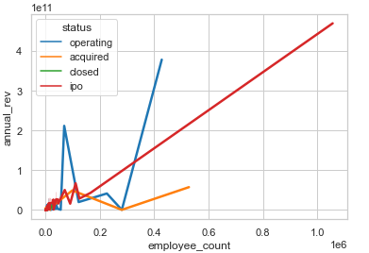
Testing relationship
Let's see if the relationship between the number of employees is proportional with the success of the company in other words operating or not.
we will correlate it with the annual revenue of the company. The annual revenue will definitely show how the company is doing.
There's seemingly a direct proportional relation between the number of employees and the annual revenue.

Slide 71
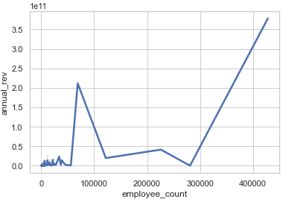
Operating Companies
it is seen that with the increase in the number of employees, the annual revenue increases with it.
Looking at the graph there is what seems like a point where if it's reached, there is a clear direct relation between both attributes.
It means that companies may suffer in achieving high profit until a certain point.

Slide 72
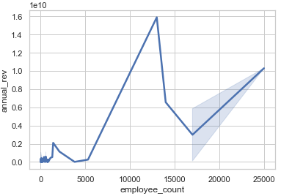
Closed Companies
From the previous graph, a similar pattern is recognized from the previous graph. Here, the closed companies the maximum number of employees and annual revenue reached is noticeably way less than the operating companies which is reasonable. Having more than 5000 achieve reasonable profits.

Slide 73
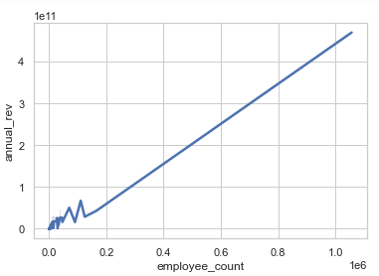
IPO Companies
IPOs can have a huge number of employees since they are publicly offered for stock sharing
From the pattern seen from past graphs, hiring more employees help in increasing annual revenues.
By this graph, it is clearly seen that the number of employees is directly proportional with the number of employees.

Slide 74
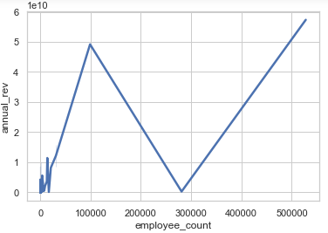
Acquired Companies
Since those companies are acquired so having much employees should be achievable due to the addition of the old employees to the ones working in the acquired one.
So, the increase of employees definitely helped in increasing the annual revenue of the company.

Slide 75
Conclusion
In conclusion, the number of employees can be considered directly proportional with the annual revenue although of course there are other factors that affect the revenue, but hiring intel and labor can increase productivity and its cost doesn't impact the company in a negative manner.

Slide 76
Question:
11
Can the number of technologies used by companies affect the rate of its success or failure?

Slide 77
Solution:
11
Two Factors Are Considered:
1. Amount Of Funds
2. Time Before First Fund

Slide 78
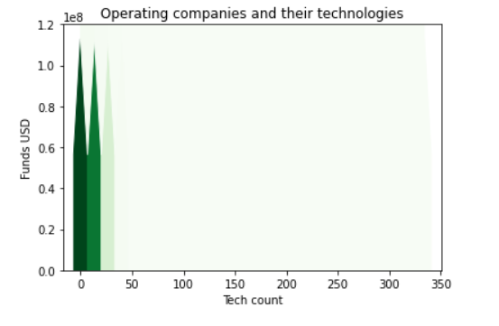
Why acquisition happens?
Cases
High funding and little technology count
High funding and high technology count
Low funding and high technology count

Slide 79

Hypothesis Testing

Slide 80
Hypothesis Testing using T test
Using T test, we will test if the effect of the number of employees and the effect of the number of technologies used on the company's success are equal
H0: The effect of the number of employees and the effect of the number of technologies used on the company's success are equal i.e., μ1 = μ2
H1: The effect of the number of employees and the effect of the number of technologies used on the company's success are not equal i.e., μ1 ≠ μ2

Slide 81





Calculating T test
First, we calculate the means of the two groups along with the standard error of the difference between their means using the equations shown.
Then we calculate the degree of freedom by adding the length of the two groups and subtracting two from the addition result.
$$t= \frac{{\overline{x}}_{1}−{\overline{x}}_{2}}{S_{x_{1}− x_{2}}}$$
${\overline{x}}_{1}=$Mean of group 1
${\overline{x}}_{2}=$Mean of group 2
$$S_{x_{1}− x_{2}}=Standard error$$
$S_{x_{1}− x_{2}}= \sqrt{(\frac{\left(n_{1}−1\right)S_{1}^{2}+\left(n_{2}−1\right)S_{2}^{2}}{n_{1}+ n_{2} − 2})(\frac{1}{n_{1}}+\frac{1}{n_{2}})}$

Slide 82
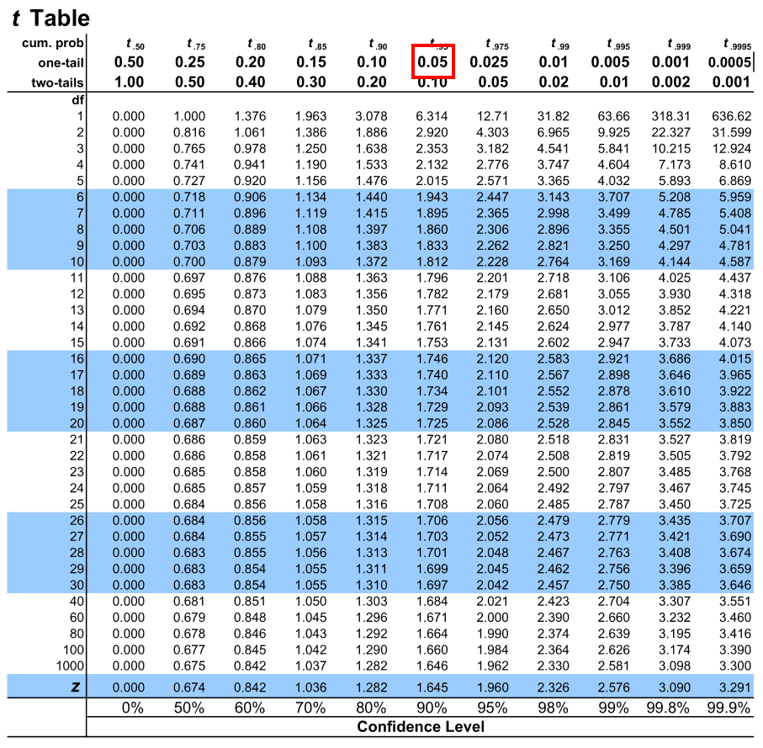
Calculating T test
Using alpha of 0.05 and degree of freedom of 100, the value from the t table is 1.66.
We take this value and compare it with the calculated t-score.
The t-score is 1.75, so it is bigger than the t-value so H0 is rejected.

Slide 83
Final THoughts

Slide 84
Many Factors can affect the success of kickstarting a startup company.
Gathering investments is one of the most critical aspects that can make a difference in a startup’s lifetime. However, the amount of funding or the time it takes for a company to get its first fund isn’t that important to the company’s success.
Each country can have its own circumstances that provide a certain environment for a startup company either from laws, tax rates, etc.
Companies need to spend more to gain more. For example, they need to hire enough labor and use sufficient technologies to achieve reasonable annual revenue.

Slide 85
THANKS!
Do you have any questions?

